Slide 1

Gym Project managment
The GymProjectApp is an application in C#, developed as part of the Advanced Programming module. The project demonstrates a two-layer architecture — Business Logic Layer (BLL) and Data Access Layer (DAL) — with integration to a SQLite database. It includes core CRUD operations, sorting and searching algorithms, and applies object-oriented programming principles.

Slide 2
Target Users / Beneficiaries
The project is designed to benefit individuals and organizations involved in gym and fitness management.
🧑‍💼
Gym Administrators / Staff: They can efficiently manage member records, product inventories, and membership plans without relying on manual paperwork.
Gym Members: Members benefit from accurate record-keeping of their personal details, membership type, and payment history, ensuring transparency and reliability.
Trainers / Trainees (Future Extension): Trainers can track trainee progress and assign workout plans, while trainees can have their exercise categories and schedules recorded in the system.
Business Owners: Gym owners can monitor product sales, membership statistics, and financial transactions, helping them make informed business decisions.
🏋️
📋
💼

Slide 3
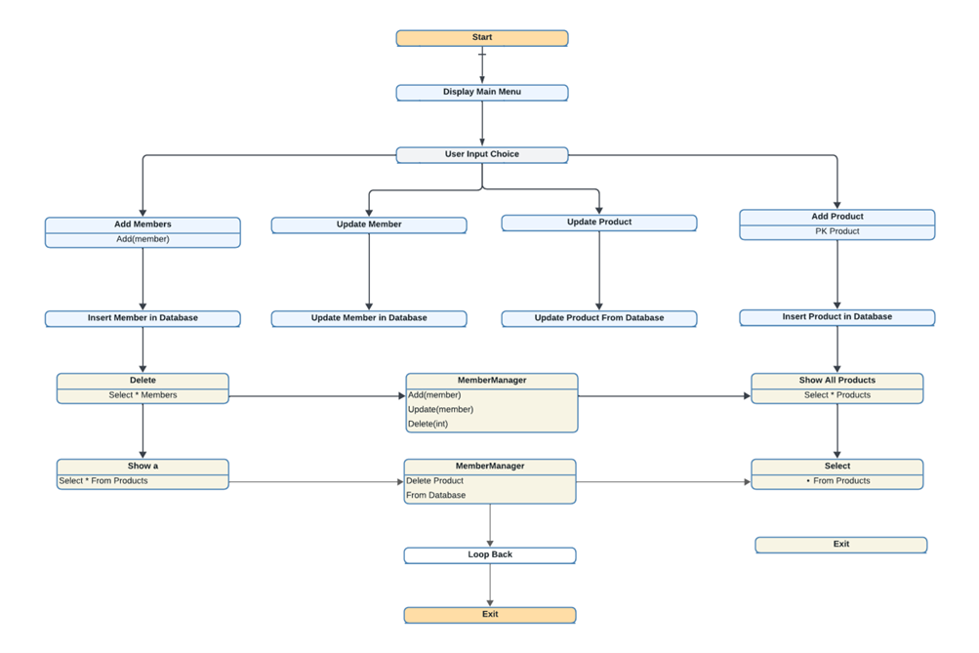
Flowchart
System Design Architecture
The flowchart represents the execution flow of the main menu, showing how the system responds to user actions.
CRUD operations are distributed across layers in a clean and maintainable way, supporting scalability and clarity.

Slide 4
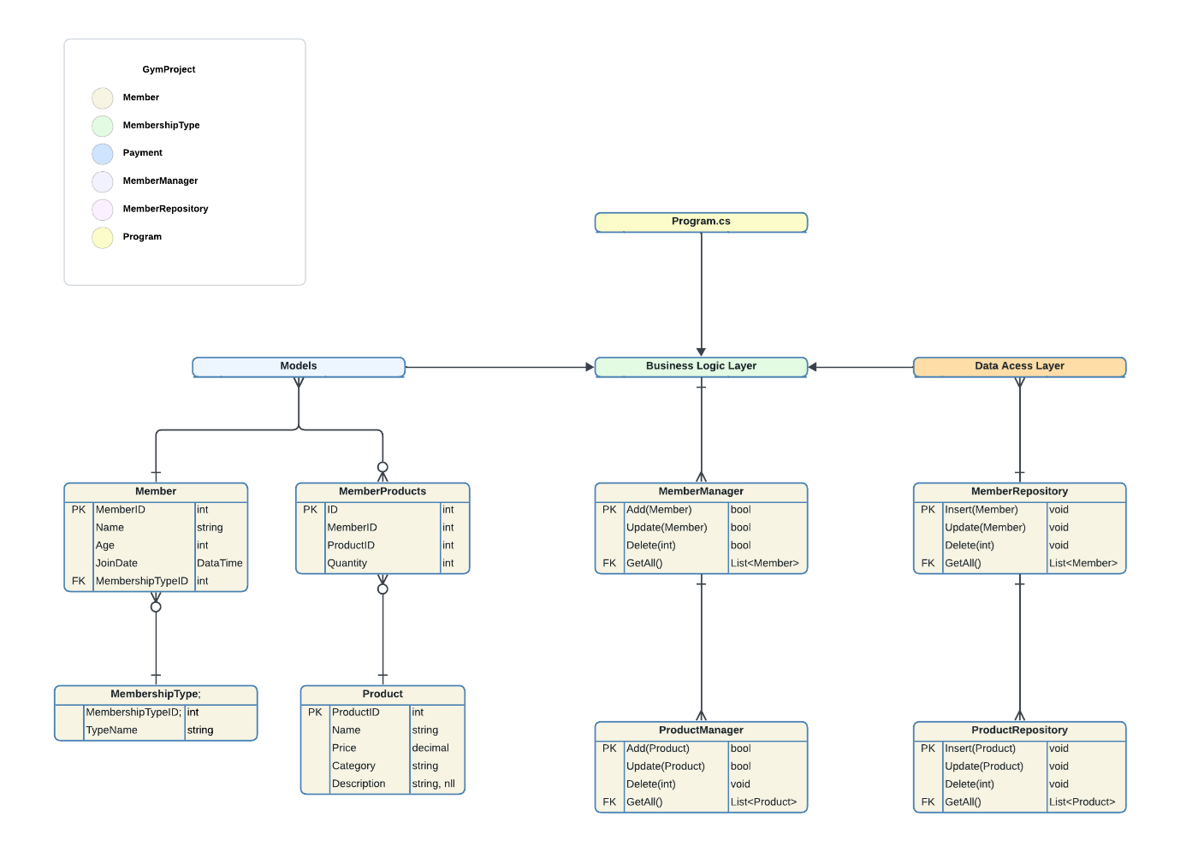
ERD Diagram
ERD Diagram illustrates the layered architecture, separating models, business logic, and data access components.
Integration between program, manager and repositories, and the SQLite database ensures persistence and modularity.

Slide 5
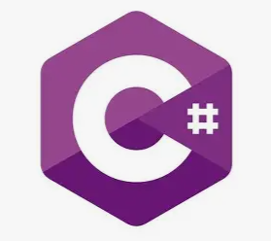
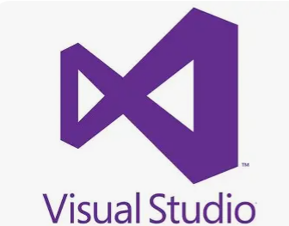


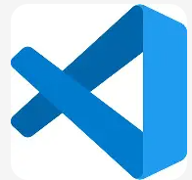
Technologies Used
.NET C# (Business Logic Layer – BLL): Used to implement the core application logic, including managers (MemberManager, ProductManager) and user interactions. C# provides strong type safety, object-oriented design, and integration with Visual Studio.
SQLite (Data Access Layer – DAL): A lightweight relational database used to persist data for members and products. The repositories (MemberRepository, ProductRepository) handle CRUD operations directly with SQLite.
SQL Queries: Employed for database operations such as INSERT, UPDATE, DELETE, and SELECT to manage records efficiently.
Visual Studio / VS Code: Used as the primary IDEs for coding, debugging, and project organization.
GitHub Desktop & GitHub Repository: For version control, project backup, and collaboration. The project is uploaded to the Advance-Programming repository for academic submission in Github website.
Lucidchart: Utilized to design ER Diagrams, Flowcharts and more with professional clarity.

Slide 6
Project Features
Insert (Add): Users can add new members and products into the system. Each record is stored persistently in the SQLite database, ensuring data is not lost when the application closes.
Delete (Remove): Existing members or products can be deleted by specifying their unique ID. This operation ensures that outdated or incorrect records are removed from the database.
Update/Modify: The application allows updating member details (e.g., name, age, membership type) and product details (e.g., name, price, category). This ensures that information remains accurate and up to date.

Slide 7
Future Work
By introducing additional features that will improve usability and scalability. Some of the planned improvements include:
Graphical User Interface (GUI): Replace the console-based interface with a user-friendly graphical interface to make navigation easier for non-technical users.
Reporting Module: Add functionality to generate reports such as membership statistics, payment summaries, and product sales.
Search and Filter Options: Improve data handling by allowing advanced search and filtering of members and products
Authentication and Security: Implement login and role-based access control to ensure data privacy and secure operations.
Payment Integration: Extend the system to handle membership payments and track financial transactions
Cloud/Network Support: Enable multi-user access by connecting the application to a cloud database or networked environment.
Trainee Management: Introduce a trainee module to track workout plans, progress, and assigned trainers.
Sales Tracking: Add a sales module to monitor product sales, revenue, and inventory levels.

